Slide 1
Employee Data Analysis using Excel
STUDENT NAME: R.kiruthika
REGISTER NO: 312220253
DEPARTMENT:commerce
COLLEGE: jeppiaar college of arts and science

Slide 2
Employee Performance Analysis using Excel
- Track key performance indicators (KPIs) such as sales numbers, customer satisfaction ratings, and project completion rates - Identify top performers and areas for improvement - Provide personalized feedback and development plans - Analyze trends and patterns in performance over time - Make data-driven decisions about talent management and resource allocation

Slide 3


AGENDA
Problem Statement
Project Overview
End Users
Our Solution and Proposition
Dataset Description
Modelling Approach
Results and Discussion
Conclusion
3/21/2024 Annual Review

Slide 4

PROBLEM STATEMENT
An employee performance problem statement typically outlines specific issues affecting an employee's work performance. It should:
Clearly describe the problem
2. Focus on behavior or performance, not personality
3. Be specific, objective, and measurable
4. Indicate how the problem affects the team or organisation.

Slide 5

PROJECT OVERVIEW
A project overview for employee performance analysis typically includes:
Project Objective: To evaluate and improve employee performance, identify strengths and weaknesses, and provide insights for informed decision-making.
Scope: Define the departments, teams, or specific employees to be analyzed.
Methodology: - Data collection (e.g., performance metrics, feedback forms, surveys) - Data analysis (e.g., statistical models, benchmarking) - Performance indicators (e.g., sales, productivity, quality)
Key Performance Indicators (KPIs): Quantifiable metrics to measure employee performance, such as: - Sales revenue - Task completion rate - Customer satisfaction - Attendance

Slide 6

WHO ARE THE END USERS? End users are the individuals who ultimately use a product, service, or system. They are the ones who interact with it, benefit from it, and may also experience any issues or limitations.

Slide 7

OUR SOLUTION AND ITS VALUE PROPOSITION
The solution is a product, service, or system that addresses a specific problem, need, or opportunity. The value proposition is the unique benefit or advantage it offers to end users, making it appealing and relevant to them.
Key benefits: What specific advantages does your solution offer?
Unique differentiators: What sets your solution apart from others?
3. Target audience: Who is your solution designed for?
4. Problem-solving: How does your solution address a specific pain point or need?

Slide 8
Dataset Description
A dataset for employee performance analysis might include the following information:
Employee ID (unique identifier)2
Name
Job Title/Role
Department
Performance Metrics (e.g., sales numbers, project completion rates, customer satisfaction scores)
Goals and Objectives (individual and team-based)
Feedback and Evaluation Scores (from managers, peers, or self-assessments)

Slide 9

THE "WOW" IN OUR SOLUTION
Wow Factors:
1. Predictive Analytics
2. Personalized Development Plans
3. Real-time Feedback and Coaching
4. Bias-Free Evaluations
5. Holistic View
6. Gamification and Engagement
7. Scalability and Flexibility
8. Data-Driven Storytelling
3/21/2024 Annual Review
9

Slide 10
MODELLING
Modeling in employee performance analysis involves using statistical, machine learning, or other analytical techniques to identify relationships, trends, and patterns in data related to employee performance.
Regression Models
Clustering Models
Decision Tree
Random Forest
Neural Networks
Time Series Analysis
Survival Analysis
Network Analysis
Text Analytics
10

Slide 11
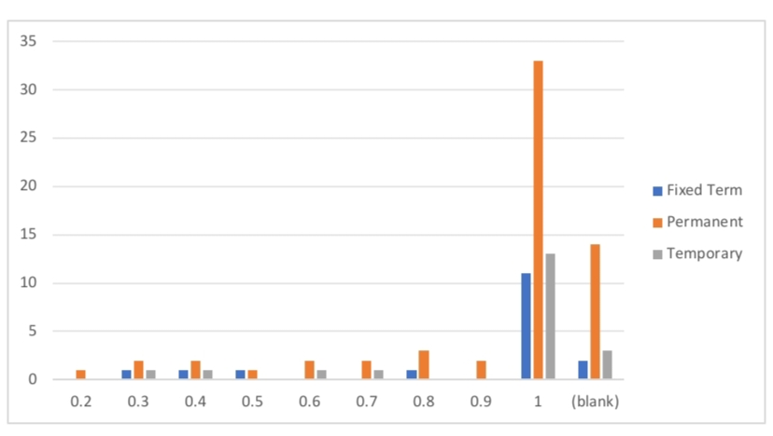
RESULTS
11

Slide 12
conclusion
"By leveraging Excel to analyze employee performance, organizations can unlock powerful insights, drive business success, and foster a culture of continuous improvement. With automated data collection, visualization, and analysis, HR professionals and managers.

